Slide 1


Secure Email Exchange
Encryption-Decryption
Key Delivery
Signature
Merkle–Hellman knapsack
EC EL-GAMAL
FEAL in CFB mode
Nuwar Dabbah – 213911548​
Anood Naim - 324222553 ​
Samira Dabbah​ - 323069484
Reema Nasr - 211940952

Slide 2


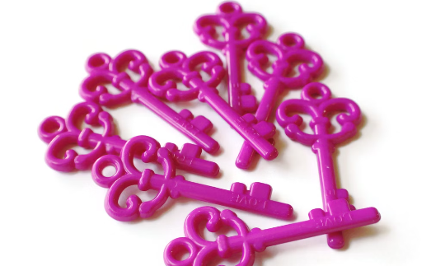

FEAL: A Faster Encryption Solution
Faster Encryption
Efficient Key Generation
Secure Data Protection
FEAL, or the Fast Data Encipherment Algorithm, was designed in the late 1980s as a speedier and simpler alternative to the popular Data Encryption Standard (DES).
The FEAL algorithm includes a key generation process that produces round keys for efficient encryption and decryption of data.
FEAL uses a series of rounds and substitutions to encrypt and decrypt data, providing a robust security solution for a variety of applications.

Slide 3
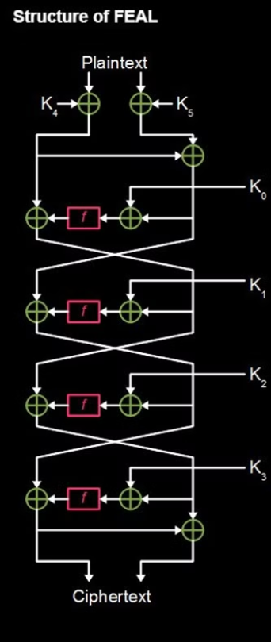
Basic Structure of FEAL​
Block Size: 64 bits​
Key Size: 64 bits
Rounds: Varies by version (FEAL-4 has 4 rounds, FEAL-8 has 8 rounds, etc.)

Slide 4
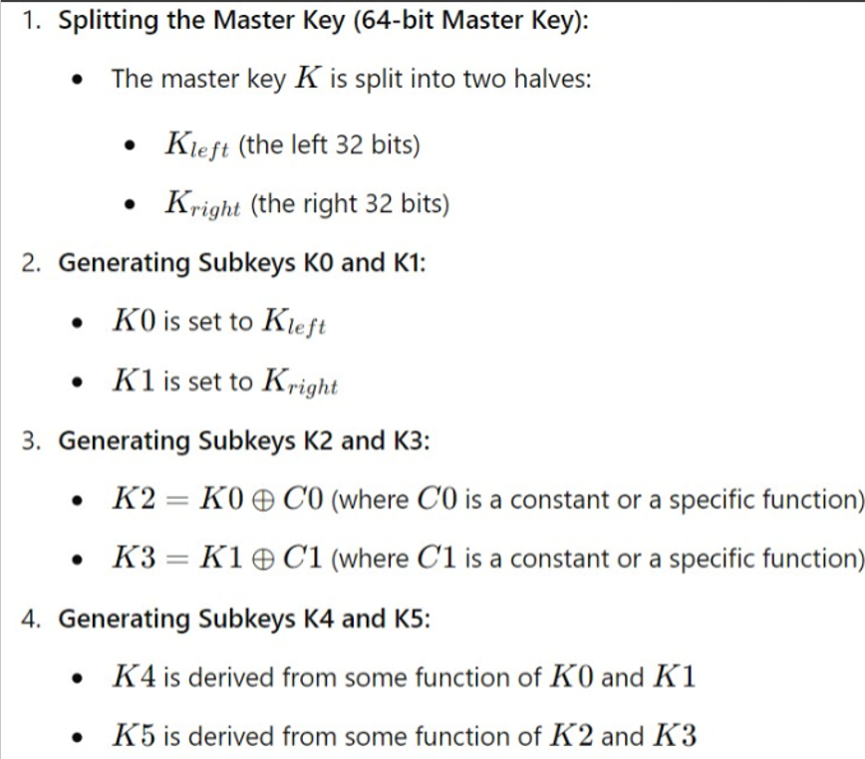
Key Generation
of FEAL

Slide 5
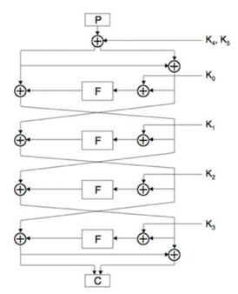
Encryption
Plaintext : P
Ciphertext : C
Round function :F
32 bit subkey: K0 ….. K5

Slide 6
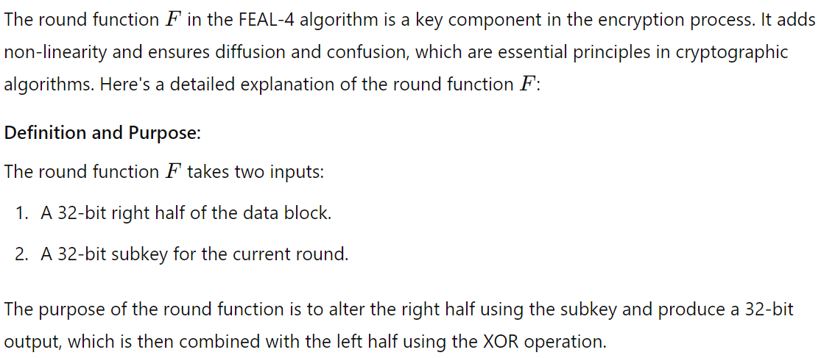
The Round Function in FEAL-4
.

Slide 7
Decryption
Follow these steps to decrypt your secure data:
Start with the ciphertext block and split it into two equal parts: Left (L) and Right (R).
.
1
2
Use the subkeys in reverse order: apply K4, K3, K2, and K1 sequentially
Applying the round function in reverse order:
For each decryption round (starting from round 4 to round 1), compute the F function using the right part (R) and the current subkey (K_i), update the left part (L) using XOR with the result, and then swap the left and right parts for the next round.
3
4
Combining the Left and Right Parts:
After completing all rounds, combine the final left and right parts to form the decrypted block.
Applying the Inverse Initial Permutation (if any):
If an initial permutation was applied during encryption, apply its inverse permutation to the final result to obtain the original plaintext.
5

Slide 8
FEAL vs DES

Slide 9
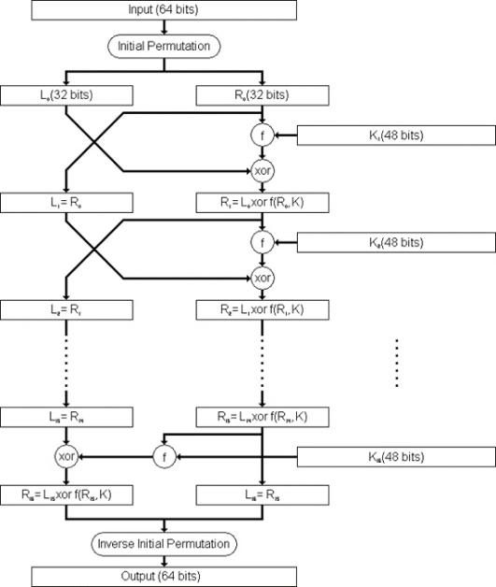
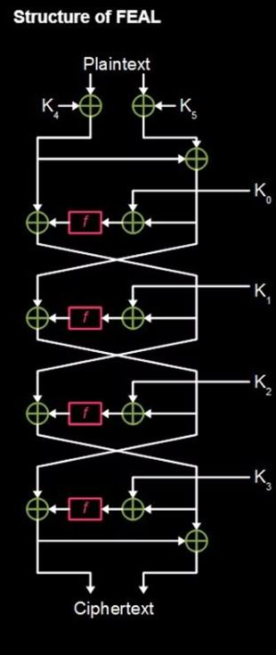
DES
FEAL

Slide 10
FEAL VS DES​
Feature
DES (Data Encryption Standard)
FEAL (Fast Data Encipherment Algorithm)
1
Year of Introduction
1977
1987
2
Block Size
64 bits
64 bits
3
Key Size
56 bits (effective)
64 bits

Slide 11
4
Structure
Feistel network
Feistel network
5
S-Boxes
8 fixed S-boxes
Uses simpler S-boxes
6
Security
Considered insecure by modern standards; vulnerable to brute-force attacks and differential cryptanalysis
Vulnerable to differential and linear cryptanalysis, considered insecure
Slower compared to modern algorithms
Designed to be faster and simpler
7
Performance
8
Cryptographic Analysis
Extensively analyzed, numerous attacks and weaknesses identified
Found to be weak against several forms of cryptanalysis

Slide 12
CFB MODE
ECB - Electronic Codebook
CBC - Cipher Block Chaining
CFB – Cipher Feedback
OFB – Output Feedback
CTR – Counter

Slide 13
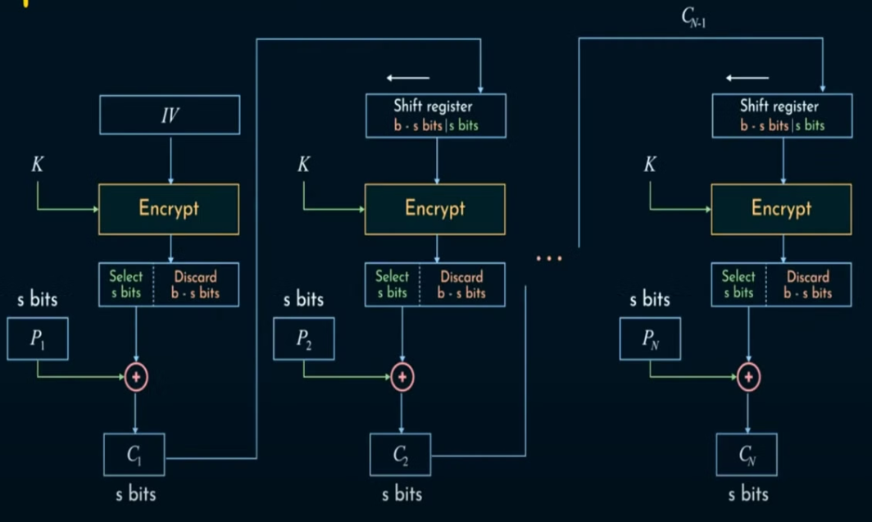
Encryption
Xi = Xi-1[s:] || Ci-1
X0 = IV
Ci = Ek(Xi)[:s] XOR Pi

Slide 14
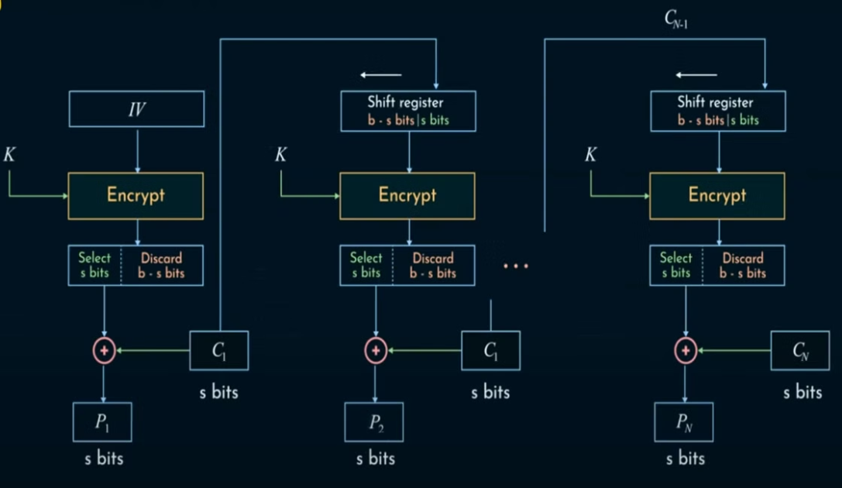
Decryption
Xi = Xi-1[s:] || Ci-1
X0 = IV
Pi = Ek(Xi)[:s] XOR Ci

Slide 15
The symmetric algorithm does not have to be reversible
Encrypting the same plaintexts under the same key, but different IVs result in different ciphertexts
The IV can be sent in clear but avoiding the reuse of the IV
Ciphertext block Cj depends on Pj and all preceding plaintext blocks
Block → Stream cipher (by generating a keystream using the symmetric cipher)
No need for padding since it works on the level of bits

Slide 16

Merkle-Hellman Knapsack
The Merkle-Hellman knapsack cryptosystem is a public-key encryption algorithm proposed by Ralph Merkle and Martin Hellman in 1978.

Slide 17

Algorithm Overview
1
Key Generation
1
Create a superincreasing sequence and multiply by a modulus.
2
Encryption
2
Convert plaintext to binary and multiply with public key.
3
Decryption
Use private key to solve the subset sum problem.

Slide 18
Superincreasing Sequence
Definition
Example
Each element is greater than the sum of all previous elements.
The sequence {2, 3, 6, 13, 27, 52} is superincreasing.
Importance
Crucial for the security and functionality of the algorithm.

Slide 19

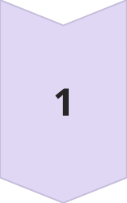
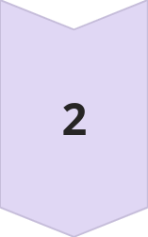
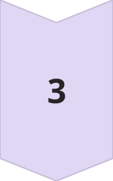
Key Generation Process
Create Sequence
Generate a superincreasing sequence of positive integers.
Choose Modulus
Select a modulus larger than the sum of the sequence.
Multiply
Multiply each element by a coprime number modulo the modulus.

Slide 20

Encryption Process
1
2
3
Convert Message
Multiply
Sum
Multiply each bit with corresponding public key element.
Add the results to obtain the ciphertext.
Transform the plaintext message into a binary sequence.

Slide 21
Decryption Process
Modular Arithmetic
1
1
Calculate Modular Inverse:
Compute the modular inverse $w^{−1}$ of the multiplier w used in the encryption.
Compute Intermediate Value: Use the modular inverse to find $C^{′}$ calculating
${ C}^{′}=C∗w^{−1}$ mod m
2
Subset Sum Problem
2
Next, the algorithm solves the subset sum problem to reconstruct the binary sequence that was encrypted using the public key.
Message Conversion
3
3
Finally, the binary sequence is transformed back into the original plaintext message, completing the secure decryption process.

Slide 22

EC El-Gamal Signature

Slide 23
Digital Signature
A digital signature is a mathematical technique used to validate the authenticity (Bob can be sure that Alice and not Eve was the signer and the sender), integrity of a digital document, message or software (Bob knows Eve didn’t change the message) and non-repudiation (Alice cannot falsely claim that she didn’t sign the message).
work
verified
uses
They work by attaching a unique, unchangeable code to the document using a combination of the sender's private key and complex mathematical algorithms.
The signature can be verified using the sender's public key.
Digital signatures are very secure and are used in a variety of applications. commonly used in contract-heavy industries (such as: Government, Healthcare, Manufacturing, Financial services, etc.)

Slide 24
Elliptic-curve cryptography (ECC)
ECC is an approach to public-key cryptography based on the algebraic structure of elliptic curves over finite fields.
ECC allows smaller keys compared to non-EC cryptography (based on plain Galois fields) to provide equivalent security.
Every user has a public and a private key
Public key is used for encryption/signature verification
Private key is used for decryption/signature generation
What exactly is an elliptic curve?
Let a ∈ ℝ, b ∈ ℝ, be constants such that 4a³ + 27b² ≠ 0.
A non-singular elliptic curve is the set E of solutions (x,y) ∈ ℝ x ℝ to the equation: y² = x³ + ax + b , together with a special point O called the point at infinity

Slide 25
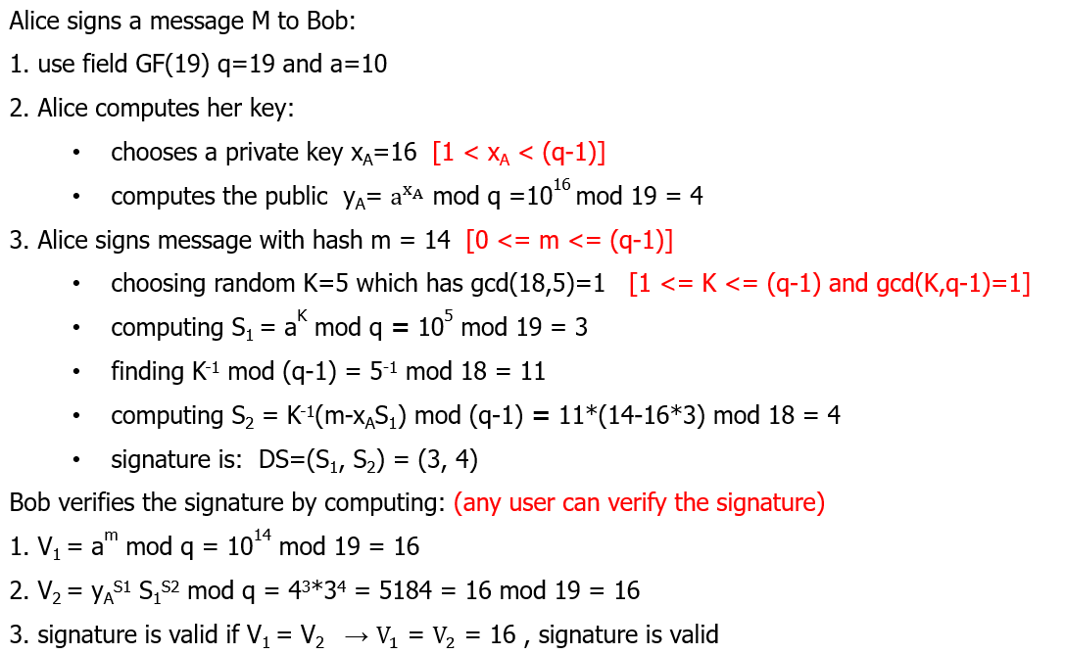
ElGamal Digital Signature
The ElGamal signature scheme is a digital signature scheme based on the algebraic properties of modular exponentiation, together with the discrete logarithm problem.
The algorithm uses a key pair consisting of a public key and a private key
Private key is used to generate a digital signature for a message (use private key for encryption).
Signer’s public key is used to verify the signature. (uses public key for decryption)

Slide 26
3 Steps to EC ElGamal Digital Signatures
Key Generation
1
Generate a private key and compute the public key
Signing
2
Use the private key to create a digital signature
Verification
3
Validate the signature using the public key
The EC ElGamal digital signature scheme consists of three main steps: key generation, signing, and verification. First, a private key is generated and used to compute the corresponding public key. Then, the private key is employed to create a digital signature for a message. Finally, the signature is verified using the public key to ensure the message's authenticity and integrity.

Slide 27


Key Components
The key components of the EC ElGamal digital signature scheme are the private and public keys
Private Key ($d_{A}$ ):
A secret number chosen by the signer (Alice)
Must be kept confidential
Public Key ($Q_{A}$):
Computed as $Q_{A}= d_{A} ∗ G$
G is a predetermined base point on the elliptic curve
Publicly shared
n: prime order
P: field over prime p

Slide 28
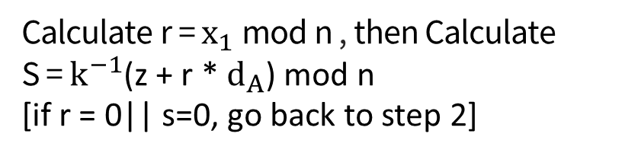
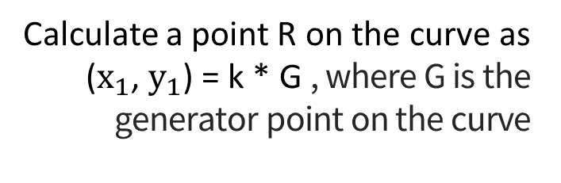
Signing Process
Hash the Message
1
The signer hashes the message and computes z as the n leftmost bits of e, where e is the hash of the message.
2
Choose Random Number
select a random number k in the range [1, n-1] that is private and new for every message we send, where n is the order of the curve, ensure that gcd(n-1, k) = 1.
Compute R
3
Calculate a point R on the curve as ($x_{1}$, $y_{1}$) = k * G , where G is the generator point on the curve
4
Calculate S
To Compute S using the private key, message hash, and previously calculated values.
Output Signature
5
Signature is the pair (r, s) , Send (r, s) along with the message
Calculate r = $x_{1}$mod n , then Calculate S = $k^{−1}$(z + r * $d_{A}$) mod n
[if r = 0|| s=0, go back to step 2]

Slide 29
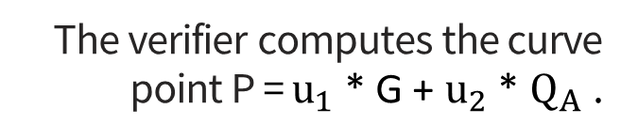
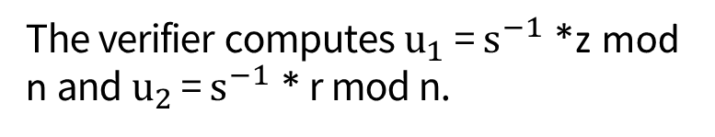
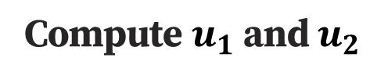
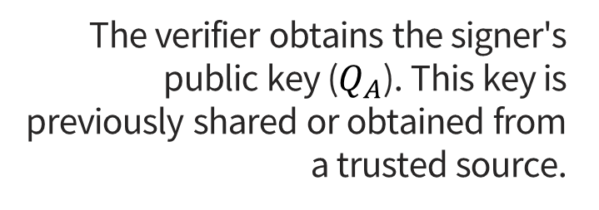
Verification Process
Obtain Public Key
1
The verifier obtains the signer's public key ($Q_{A}$). This key is previously shared or obtained from a trusted source.
2
Hash the Message
The verifier hashes the message.
Compute z
3
The verifier computes z = n leftmost bits of e.
4
Compute $u_{1}$ and $u_{2}$
The verifier computes $u_{1}$ = $s^{−1}$ *z mod n and $u_{2}$ = $s^{−1}$ * r mod n.
Compute Curve Point P
5
The verifier computes the curve point P = $u_{1}$ * G + $u_{2}$ * $Q_{A}$ .
6
Verify Signature
The verifier checks if the x-coordinate of P ≡ r. If so, the signature is valid.

Slide 30

Project Flow
1. Key Exchange
1
Alice and Bob agree on public parameters.
Generate and exchange public keys using Merkle–Hellman knapsack.
2
2. Encryption and Signature
Sign the public keys using EC El-Gamal and verify them.
Alice writes a message and generates a digital signature using EC El-Gamal.
Encrypts the message using FEAL in CFB mode with a randomly generated IV.
3. Decryption and Verification
3
Transmit the ciphertext, IV, and signature to Bob.
Bob receives the encrypted message.
Decrypts the message using FEAL in CFB mode.
Verifies the digital signature to ensure the message integrity and authenticity.

Slide 31
Thanks for listening!
Mafhom ?

Slide 32
Reference
https://link.springer.com/content/pdf/10.1007/0-387-34805-0_59.pdf
http://theamazingking.com/crypto-feal.php
https://www.researchgate.net/figure/Data-Encryption-Standard-DES-Algorithm_fig4_321587376
https://slideplayer.com/slide/4983648/#google_vignette
https://en.wikipedia.org/wiki/Elliptic-curve_cryptography
https://www.keyfactor.com/blog/elliptic-curve-cryptography-what-is-it-how-does-it-work/
https://en.wikipedia.org/wiki/Digital_signature
https://www.geeksforgeeks.org/what-is-ecc-memory/?ref=header_search
https://en.wikipedia.org/wiki/ElGamal_signature_scheme
https://www.geeksforgeeks.org/elgamal-encryption-algorithm/
https://en.wikipedia.org/wiki/Merkle%E2%80%93Hellman_knapsack_cryptosystem
https://www.geeksforgeeks.org/knapsack-encryption-algorithm-in-cryptography/

